Slide 1
Resume Classification
Project Overview
Through the process of Natural Language Preprocessing (NLP)
From Group 4

Slide 2
CONTENTS
Business Objective
Dataset details
Preprocessing of text data
Exploratory Data Analysis (EDA)
Feature Engineering
Model Building
Model Evaluation
Deployment
Final insights and conclusions

Slide 3
Objectives
Main objectives of the project
Improve efficiency in resume screening
Reduce bias in candidate selection
Enhance candidate matching and recruitment process

Slide 4
Business Objective
Dataset
Details
The document classification solution should significantly reduce the manual human effort in the HRM . It should achieve a higher level of accuracy and automation with minimal human intervention.
The dataset consists of four categories of resumes based on the job role applied by the candidates. In total there are seventy nine resumes from different types of job.

Slide 5
Preprocessing of Text Data
Data preprocessing steps:
Converting text to lowercase
Text cleaning (removing special characters , numbers , punctuation, etc.)
Tokenization and normalization
Removal of stop words and stemming/lemmatization
Joining the words back into a single string
Visual representation of preprocessed data (word clouds, histograms)
Check for imbalance in data
from nltk.corpus import stopwords
from nltk.tokenize import word_tokenize
from nltk.stem import WordNetLemmatizer

Slide 6
Exploratory Data Analysis (EDA)
Exploratory data analysis (EDA) is performed with a wide range of visualization plots ,including box plots , count plots ,heat maps and pair plots on resume data
Hist plots are plotted to analyze the document length for various categories of resumes
Text data analysis is carried out using count plot visualization for most common words
Import matplotlib.pyplot as plt
import seaborn as sns
from collections import Counter
import pandas as pd

Slide 7
Feature Engineering
TF-IDF (Term Frequency-Inverse Document Frequency)
Word embeddings
TF-IDF vectorization is implemented to transform raw textual data into meaningful numerical features that are well-suited for machine learning algorithms to classify and analyze resumes effectively
Word embeddings are incorporated using Word2Vec and PCA techniques to improve the representation of textual data and capture semantic relationships
from gensim.models import Word2Vec
from sklearn.decomposition import PCA
From sklearn.feature_extraction.text import TfidfVectorize
tfidf_vectorizer = TfidfVectorizer()

Slide 8
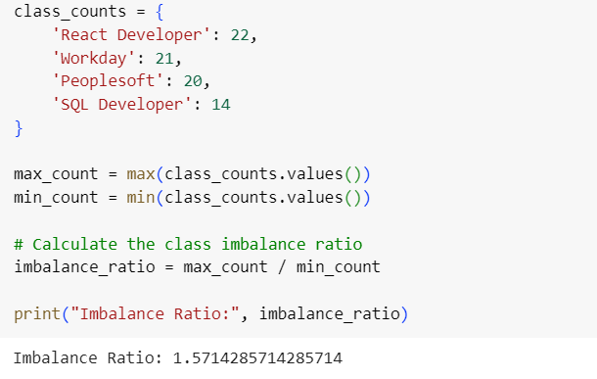
Check for Imbalance in data
With an imbalance ratio of approximately 1.57, it indicates that the dataset is slightly imbalanced, but not so severely.

Slide 9
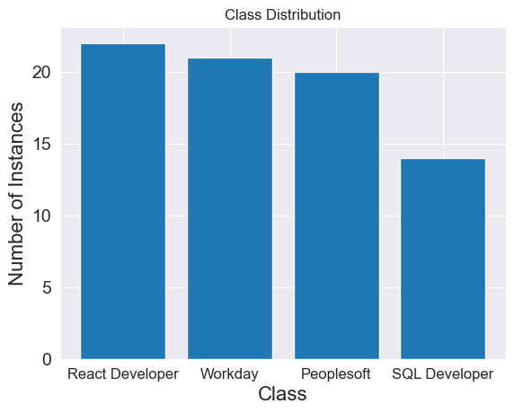
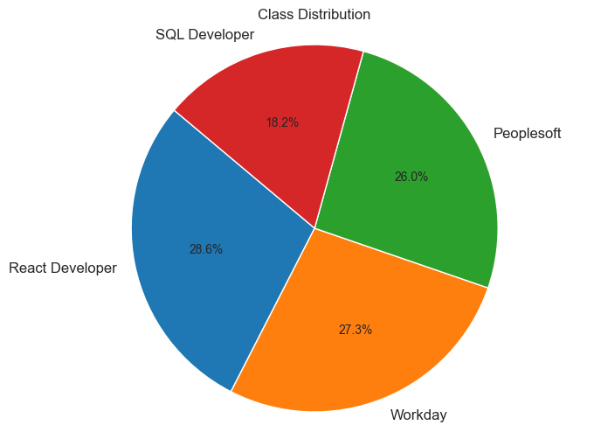

Slide 10
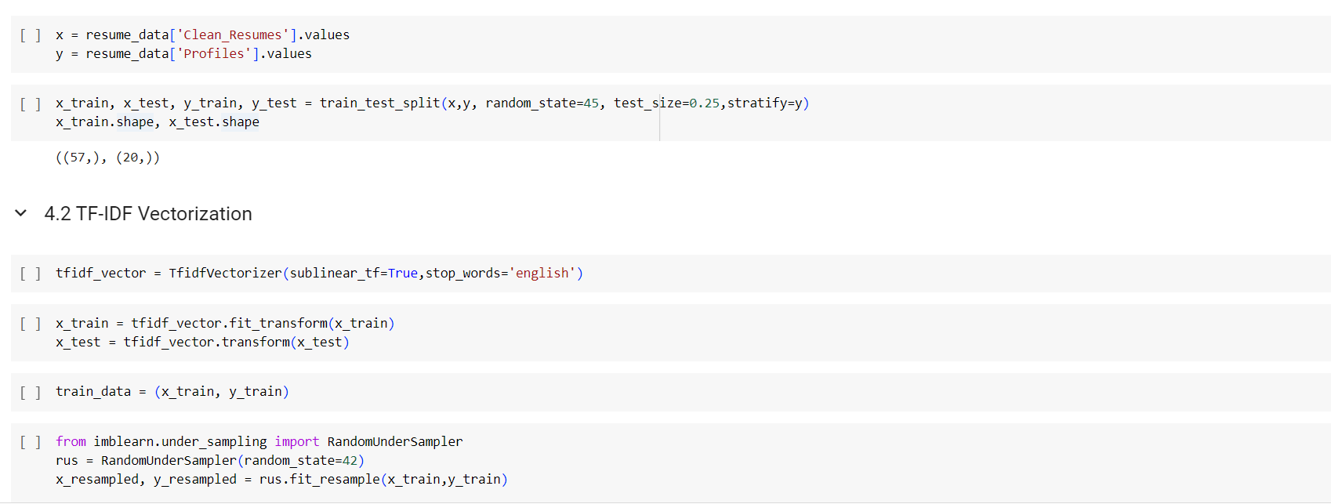
Model Building
Splitting data into train and test
x_resampled and y_resampled are the balanced set of data

Slide 11
Model Building Techniques
KNN Classifier
Employed KNN classifier to handle multi-class problems and simple implementation of the model.
Precision(%) : 0.53
Recall(%) : 0.60
F1-Score : 0.53
Decision Tree technique is used to perform resume classification based on hierarchical decision rules, feature selection and handles non-linear relationships.
Precision(%) : 0.95
Recall(%) : 0.95
F1-Score(%) : 0.94
Random Forest for resume classification to handle complex features and interactions,achieving high accuracy, reduces overfitting and handles missing values
Precision(%) : 1.00
Recall(%) : 1.00
F1-Score(%) : 1.00
Decision Tree
Random Forest

Slide 12
SVM technique is used to find optimal decision boundaries
and for handling non-linear data
Precision(%) : 1.00
Recall(%) : 1.00
F1-Score(%) : 1.00
Bagging Classifier is implemented to reduce variance, overfitting and robust to noise and improve stability
Precision(%) : 1.00
Recall(%) : 1.00
F1-Score(%) : 1.00
AdaBoost for resume classification is employed to boost weak learners' performance, reduces bias, handles noisy data
Precision(%) : 1.00
Recall(%) : 1.00
F1-Score(%) : 1.00
SVM
Bagging Classifier
AdaBoost
Gradient Boosting
Gradient Boosting for resume classification to improve model accuracy iteratively ,handles complex interactions and reduces errors in predictions
Precision(%) : 1.00
Recall(%) : 1.00
F1-Score(%) : 1.00
Naive Bayes for resume classification based on conditional probability of features
Fast training, handles large feature spaces, works well with text data
Precision(%) : 1.00
Recall(%) : 1.00
F1-Score(%) : 1.00
Logistic Regression technique gives interpretable results, handles large datasets, works well with linearly separable data
Precision(%) : 0.94
Recall(%) : 0.82
F1-Score(%) : 0.88
Naive Bayes
Logistic Regression

Slide 13
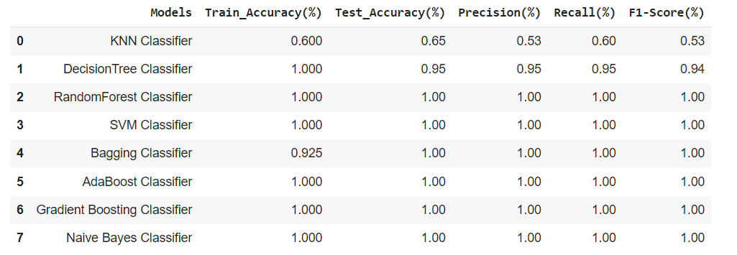
Model Evaluation

Slide 14
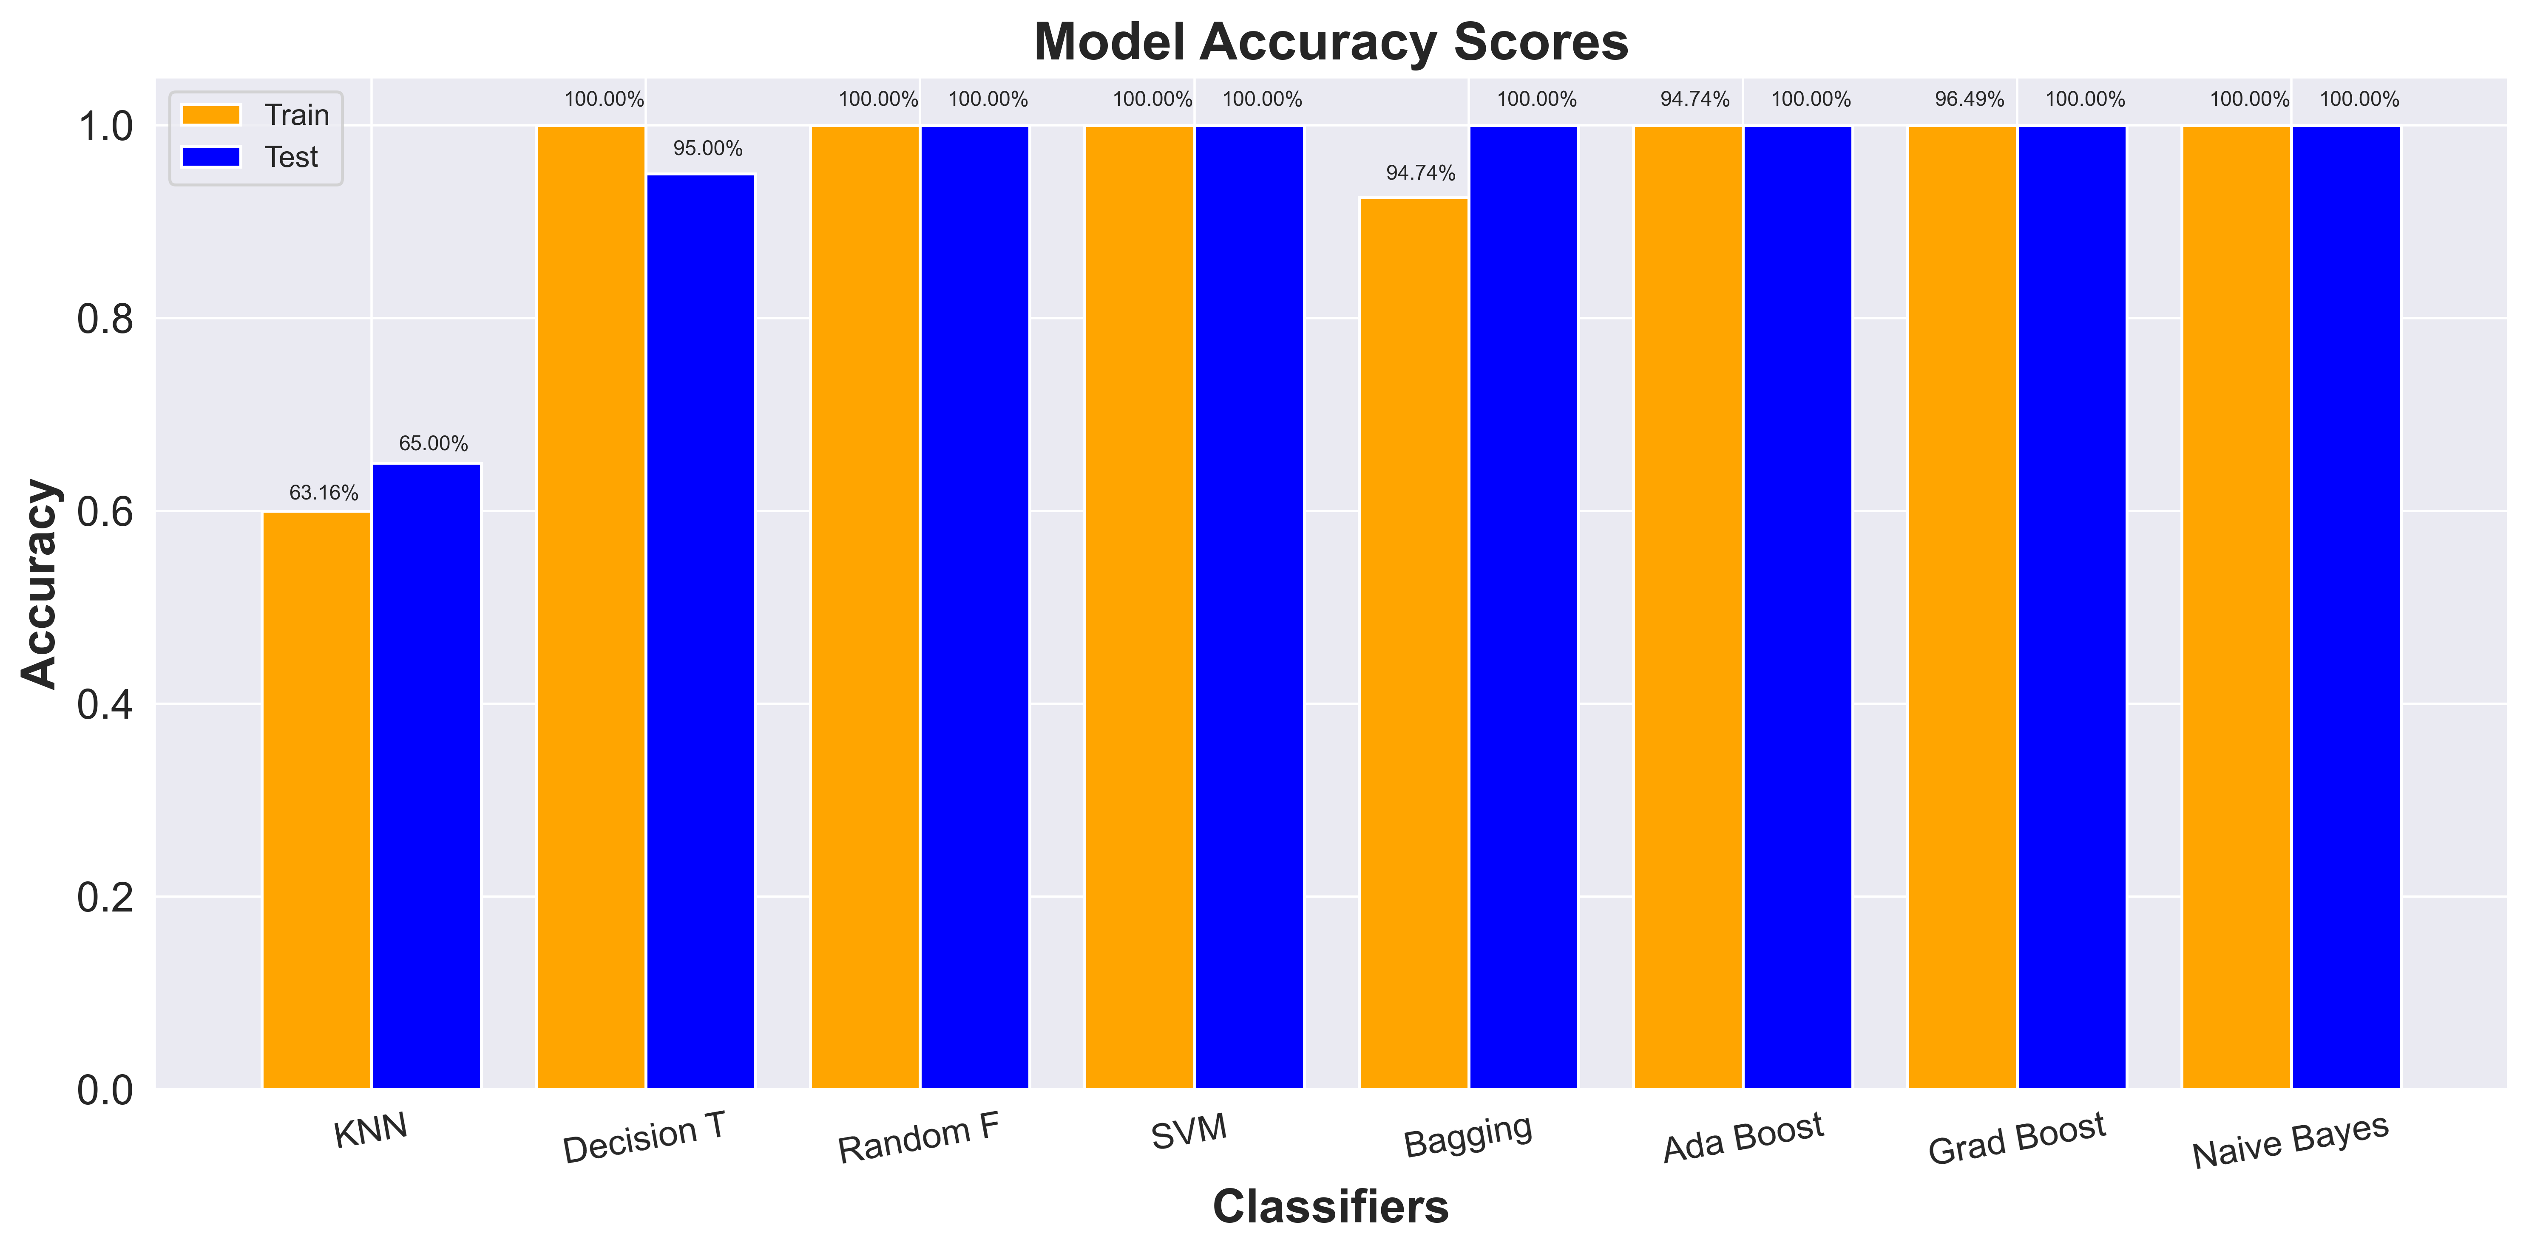
Train and Test Accuracy Plot

Slide 15
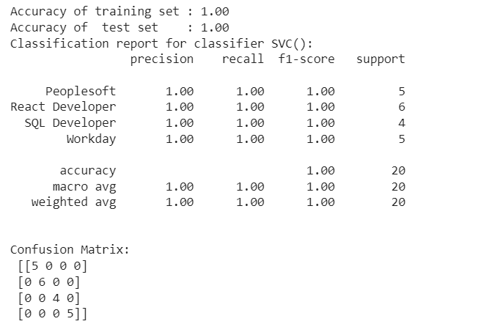
Support Vector Machine (SVM) Classifier
SVM technique is considered as our best model over other models due to its ability to find optimal decision boundaries and for handling non-linear data.
Precision(%) : 1.00
Recall(%) : 1.00
F1-Score(%) : 1.00

Slide 16
Deployment : User Interactive Web App
Pickle for Model Persistence
Utilized pickle for model serialization, ensuring the trained model's persistent storage and retrieval for seamless deployment.
Streamlit Web Application
Leveraged streamlit to develop a user interactive web application, enabling users to predict the Yearly Amount Spent based on the deployed machine learning model.

Slide 17
Final insights and Conclusions
The data is slightly imbalanced with an imbalance ratio of 1.57
SVM technique is considered as our best model over other model due to its ability to find optimal decision boundaries and for handling non-linear data.
Getting accuracy of 100%.
The Random Forest Classifier also demonstrates outstanding performance, achieving perfect accuracy scores of 1.00 on both the training and test sets.

Slide 18
Challenges Faced & Potential Solutions
1.Converting the raw data to single file format.
The raw data contained different types of files formats like doc,docx &pdf.
Solution: We imported the raw data and converted all the files to docx format,upon preprocessing the data we exported the cleaned data into a csv file.
2. Finding imbalance in data.
On modelling cleaned data almost all models giving 100% results.
Solution: Therefore we checked for imbalance in the data and found imbalance ratio of 1.57 ,that is the data is slightly imbalanced, on balancing the data we proceeded to the model building.

